Slide 1
Video Game Analysis & Technical Design
  Ch.3 Gameplay & Core Mechanics

Slide 2
Making Games Fun
Execution matters more than innovation
  The chief reason a game is not fun is that it contains elementary errors
  Aspects of game development that contribute to fun:
    50%
      Avoiding errors
      Basic craftsmanship
    35%
      Tuning and polishing
    10%
      Imaginative variations on the game’s premise
    4%
      True design innovation
    1%
      An unpredictable
      Unnamable quality
Avoiding errors, tuning, and polishing are the same practices any professional uses when crafting a product

Slide 3
Making Games Fun
Gameplay is the heart of a fun game
The player is the soul
Finding the fun factor:
  Gameplay comes first
  Get a feature right or leave it out
  Design around the player
  Know your target audience
  Abstract or automate parts of the game that aren’t fun
  Be true to your vision
  Strive for harmony, elegance, and beauty

Slide 4
A bit more on gamification….
  Jane McGonigal, Reality is Broken (2011)
  “Today, many of us are suffering from a vast and primal hunger. But it is not a hunger for food - it is a hunger for more and better engagement from the world around us....We are starving, and our games are feeding us.”
People learn much more quickly and effectively when immersed in a game.
  By playing a game developed by scientists at the University of Washington, gamers were able to map out a protein that causes AIDS in rhesus monkeys in just 10 days…..a problem that has stumped scientists for 15 years!

Slide 5
A bit more on gamification….
James Paul Gee
  We take it as completely natural that you would be in an Algebra class for 12 weeks, and then I would give you a test on Algebra .... to see if you learned any Algebra. Let’s say a kid plays Halo on Hard .... and finishes Halo. Would you be tempted to give him a Halo test? No. Not at all. You’d say the game already tested him. So let’s think - Why is it that we’re not tempted to give him a Halo test, but we are tempted to give that Algebra test and use that as a judgment? We’ll its because you actually trust the design and learning of Halo better than you trust the design and learning of that Algebra class….

Slide 6
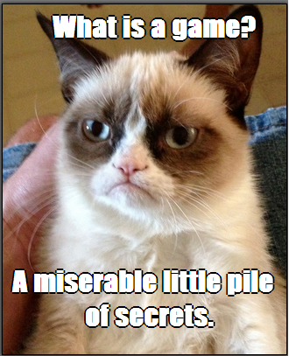
The Hierarchy of Challenges
Hierarchy from lowest to highest
  Atomic challenge
  Sub-mission
  Mission
  Complete the game

Slide 7
The Hierarchy of Challenges
Informing the player about challenges
  Games tell the player about explicit challenges
  Players discover implicit challenges on their own
  Explicit instructions are given about the victory condition and lowest-level atomic challenges
Intermediate-level challenges
  The most interesting games offer multiple ways to win
  Recognize and reward victory achieved no matter how the player achieves it

Slide 8
The Hierarchy of Challenges
Simultaneous atomic challenges
  Overcoming several atomic challenges at the same time increases the difficulty
  Common way of doing this is to bombard the player with enemies
  Other games (such as management games) present more complex interrelated simultaneous challenges
  The more simultaneous atomic challenges a player faces under time pressure, the greater the stress

Slide 9
Skill, Stress, and Absolute Difficulty
Intrinsic skill required
  The skill needed to overcome a challenge in an unlimited amount of time
Stress
  The effect of time pressure on the player’s ability to overcome a challenge
Absolute difficulty
  The skill required plus time pressure

Slide 10
Commonly Used Challenges
Physical coordination challenges
  Variations
    Test speed and reaction time
    Test accuracy and precision
    Test intuitive understanding of physics
    Test timing and rhythm
    Test ability to make combination moves
  Reduce time available to increase difficulty

Slide 11
Commonly Used Challenges
Logic and mathematical challenges
  Formal logic puzzles
    No outside knowledge required
    To increase difficulty, increase the number of objects and the ways they can be manipulated
    Players normally get all the time they need to solve
  Mathematical challenges
    Games require players to reason about probabilities
    Make educated guesses with imperfect knowledge

Slide 12
Commonly Used Challenges
Races and time pressure
  Be first to accomplish a goal
  Can be combined with other types of challenges
  Time pressure increases stress on the player
Factual knowledge challenges
  Direct tests of factual knowledge usually occur only in trivia and quiz games
  Present all the facts in the game or make it clear in advance that outside knowledge is required

Slide 13
Commonly Used Challenges
Memory challenges
  Test ability to recall things seen or heard in game
  To make it easier, give players longer to memorize and test them sooner
Pattern recognition challenges
  Test ability to recognize visible, audible, changing, or behavioral patterns
  To increase difficulty, make the pattern longer, more intricate, or more subtle

Slide 14
Commonly Used Challenges
Exploration challenges
  Spatial awareness challenges
    Test ability to learn and navigate
    To decrease difficulty, provide a map
  Locked doors
    Any obstacle that prevents the player from proceeding until he disables it
    Avoid unmarked switches far from the door

Slide 15
Commonly Used Challenges
Exploration challenges
  Traps
    Device that harms the avatar when triggered
    Fun comes from outwitting the trap
  Mazes and illogical spaces
    Every place looks alike and player must discover relationships between the areas
    Can be implemented as logic or pattern-recognition puzzles

Slide 16
Commonly Used Challenges
Exploration challenges
  Teleporters
    Mechanism that transports player to a new location
    To make the challenge easier, make the teleporter predictable and reversible

Slide 17
Commonly Used Challenges
Conflict
  Requires direct opposition of forces, some of which are under player control
  Conflict challenges can be broken down into:
    Strategy
    Tactics
    Logistics
    Survival and reduction of enemy forces
    Defending vulnerable items or units
    Stealth

Slide 18
Commonly Used Challenges
Economic challenges
  The behavior of resources creates economic challenges
    Accumulating resources
      This can be wealth, points, or anything valuable
    Achieving balance
      This can be a more interesting challenge than simply accumulating resources
    Caring for living things
      Challenges the player to meet the needs of each individual

Slide 19
Commonly Used Challenges
Conceptual reasoning and lateral thinking puzzles
  Conceptual reasoning puzzles require reasoning and knowledge to solve a problem
  Lateral thinking uses extrinsic knowledge in unexpected ways

Slide 20
Actions
Actions for gameplay
  Most actions are intended to meet challenges
  Games offer fewer actions than challenges to limit size of user interface and animation costs
  Most actions can address more than one type of challenge
Define actions
  Based on player’s role and actions to overcome challenges

Slide 21
Actions
Actions that serve other functions
  Actions not related to challenges include actions for:
    Unstructured play
    Creation and self-expression
    Socialization
    Participating in the story
    Controlling the game software

Slide 22
Saving the Game
Reasons for saving a game
  Allow player to leave and return later
  Let player recover from mistakes
  Encourage player to try alternate strategy
Consequences for immersion and storytelling
  Harms immersion
  Reduces tension

Slide 23
Saving the Game
Ways of saving a game
  Password to restart a level
  Save to a file or save slot
  Quick save
  Automatic save and checkpoints
Allow players to save and reload at will

Slide 24
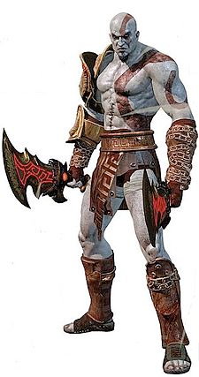
The Goals of Character Design
Games in many genres structure gameplay around characters
Characters should be distinctive and credible
The ultimate goal of character design is to create characters that
  People find appealing
  People can believe in
  The player can identify with

Slide 25
The Relationship Between Player and Avatar
Relationship varies from game to game
Factors that affect the relationship
  Did the player design the avatar?
  Is the avatar visible?
  How is the avatar controlled?

Slide 26
Player-Designed Avatar Characters
Player creates the physical attributes
Player creates the personality

Slide 27
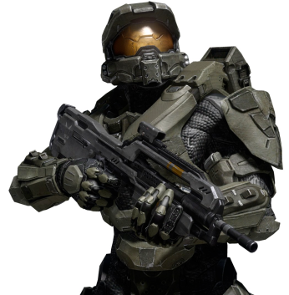
Specific and Nonspecific Avatars
Some characteristics are known, but the details are not fully fleshed out
An avatar can be a mix of the two types
  Nonspecific avatars
    Avatar is assumed to “be” the player, so appearance, personality, etc., are undefined
    Very limiting to the designer
    Common in early text-based games
  Specific avatars
    Detailed characters with histories and personalities
    Used in games with graphics and strong storylines

Slide 28
The Effects of Different Control Mechanisms
Indirect control
  Player clicks where the avatar should go
  Player is a guide to the avatar
Direct control
  Player steers the avatar
  Player is the avatar

Slide 29
Male and Female Players and Characters
Male players do not identify strongly with their avatars
  Men tend to treat avatars as puppets and often use default avatar without customizing
Women identify with their avatars
  Women tend to treat avatars as extensions of themselves and an opportunity for self-expression
  To make a game more attractive to women, allow them to customize avatar

Slide 30
Designing Your Avatar Character
How do you want the player to relate to the avatar?
Select the control method
Select the appearance and personality (unless the player designs the avatar)
  More details create more independence
  Select qualities the player will find appealing

Slide 31
Visual Appearances
Art-driven character design
  Best method for simple characters who don’t change during the game
Story-driven character design
  Best method for complex characters or characters who change during the game

Slide 32
Character Physical Types
Characters fall into three general categories:
  Humanoids
    Physical features like a human’s
  Nonhumanoids
    Shaped like vehicles or machines, animals, or monsters
  Hybrids
    Beings such as mermaids or human/machine combinations
Art-driven characters are usually stereotypes:
  Most common character stereotypes are cool, tough, cute, and goofy

Slide 33
Character Physical Types
Hypersexualization is exaggerating sexual attributes of characters
Avoid hypersexualized characters because:
  They are clichés
  They appeal only to a puerile audience
  They may turn off part of your target audience

Slide 34
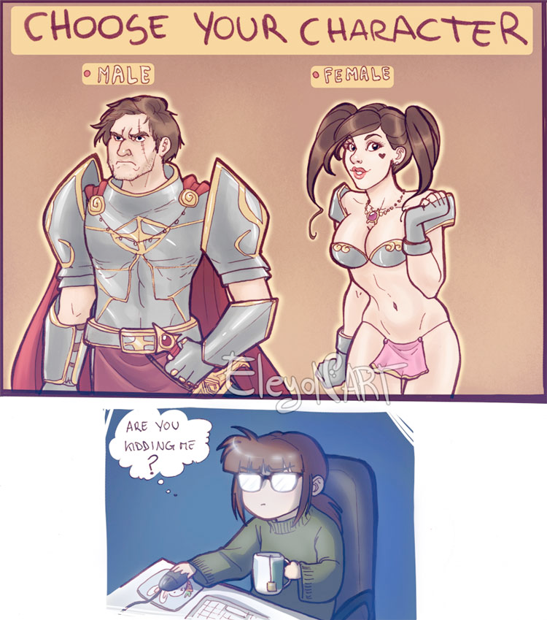
Character Physical Types

Slide 35
Clothing, Weapons, Symbolic Objects, and Names
Accessories reveal personal style
Choice of weapons can also be revealing
Transferring an object can symbolically transfer a power or reward
Names that reveal too much of the character’s personality aren’t necessary

Slide 36
Color Palette and Sidekicks
Use a signature color for the main character
Choose a color palette to reflect character’s attitudes and emotional temperament
Sidekicks offer several benefits:
  They allow you to give the player additional moves and actions
  They extend the emotional range
  They can be used to give the player information he wouldn’t get any other way

Slide 37
Creating Character Depth
You can convey a lot about a character through appearance, but not everything
If you begin character design with the character’s role, personality, and behavior, you are doing story-driven character design
You decide these things first and then let artists develop a visual appearance

Slide 38
Role, Attitude, and Values
Every character in a game plays a role
To design characters, you have to envision them and answer many questions about them
Create a backgrounder, or character background paper, for major characters
Show character personality through appearance, language, and behavior

Slide 39
Attributes
Attributes are the data values that show a character’s location, health, property, etc.
Attributes can be divided into:
  Status attributes that change frequently
  Characterization attributes that change infrequently
Attributes a character needs depend on the genre and nature of the gameplay

Slide 40
Character Dimensionality
Characters can be classified into four groups:
  Zero-dimensional characters display only discrete emotional states
  One-dimensional characters have only a single variable to characterize a changing attitude
  Two-dimensional characters are described by multiple variables that express their impulses, but those impulses don’t conflict
  Three-dimensional characters have multiple emotional states that can produce conflicts

Slide 41
Character Growth
A game that aspires to be more than a simple adventure must include character growth
To build character growth into a game, decide which characters will grow and how
  Games often use physical growth because it is easy to show and implement

Slide 42
Character Archetypes
Many stories that follow the Hero’s Journey pattern include archetypal characters
  Characters fundamental to storytelling
  Found in stories from all cultures
  May be fundamental to the human psyche

Slide 43
Audio Design
Sounds reveal the character
  Sound effects
  Vocabulary
  Grammar and sentence construction
  Accent
  Delivery
  Vocal quirks

Slide 44
Why Put Stories in Games?
Stories add entertainment
Stories attract a wider audience
Stories maintain players’ interest in long games
Stories help sell the game

Slide 45
Why Put Stories in Games?
Story should not be more important than gameplay
Factors when considering how much story to include:
  Length of the game
  Focus on individual characters
  Degree of realism
  Emotional richness

Slide 46
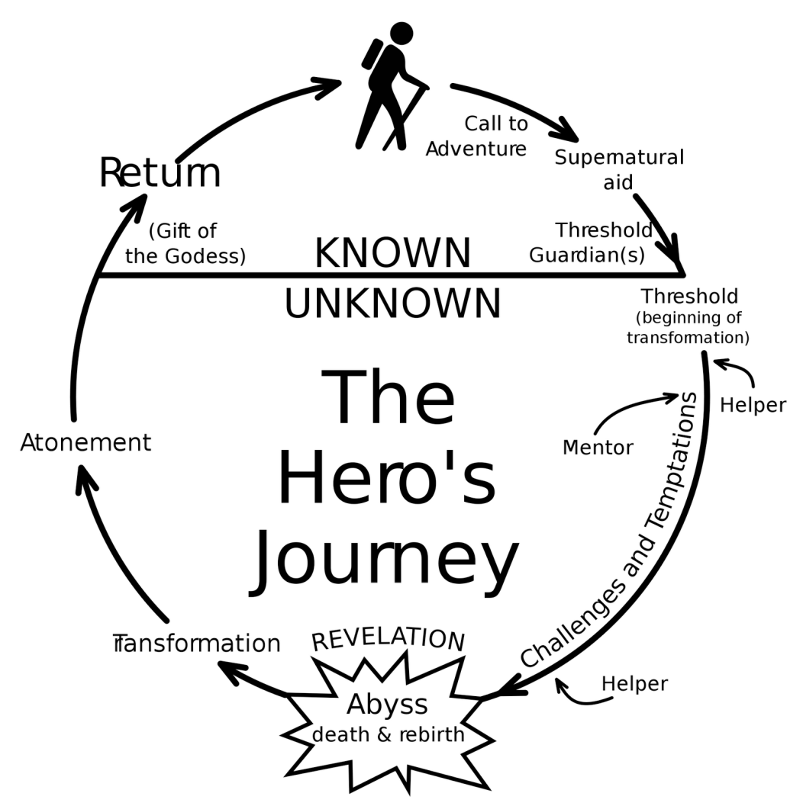
Key Concepts

Slide 47
Key Concepts
A story is an account of a series of events
Requirements of good stories:
  A good story must be credible, coherent, and dramatically meaningful
An interactive story includes three kinds of events:
  Player events
  In-game events
  Narrative events

Slide 48
Key Concepts
Narrative is the part of the story told to the player by the designer
Primary function of narrative is to present events over which the player has no control
  Narrative may be in the form of a movie, cut-scenes, scrolling text, or voiceover
  Narrative must be interruptible
  Balance narrative with action to keep players interested

Slide 49
Key Concepts
Dramatic tension is based in the story
Gameplay tension is based in the interaction
For this reason, they are not analogous

Slide 50
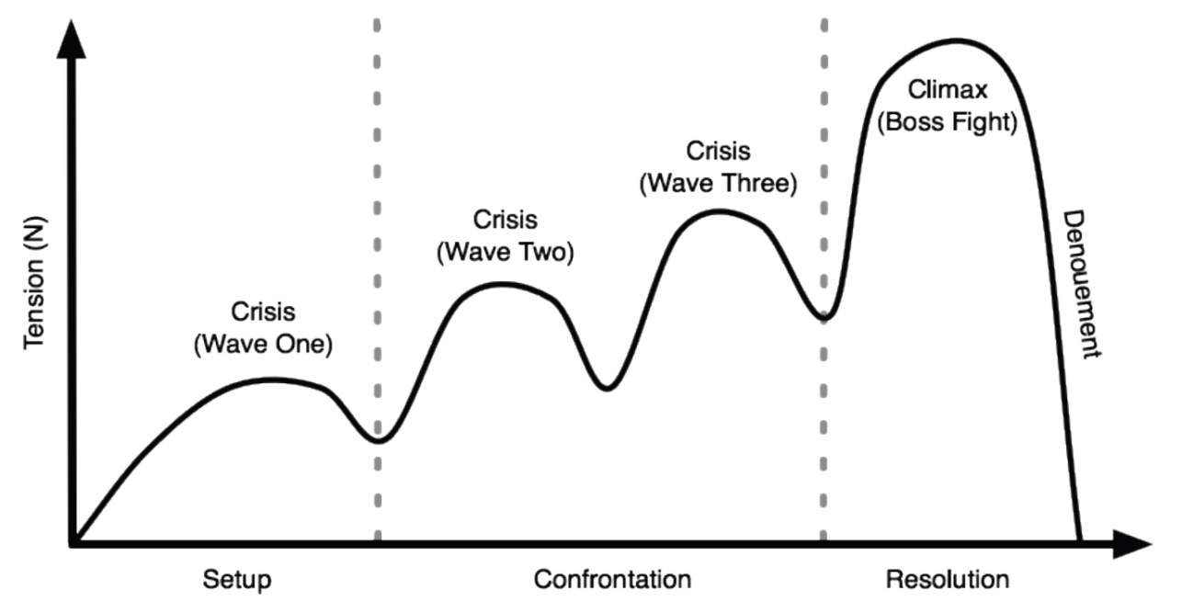
Key Concepts
Dramatic tension and gameplay tension
  Dramatic tension
    Something important is at stake. What will happen?
    Dramatic tension comes from the plot
    Fades in the presence of randomness and repetition

Slide 51
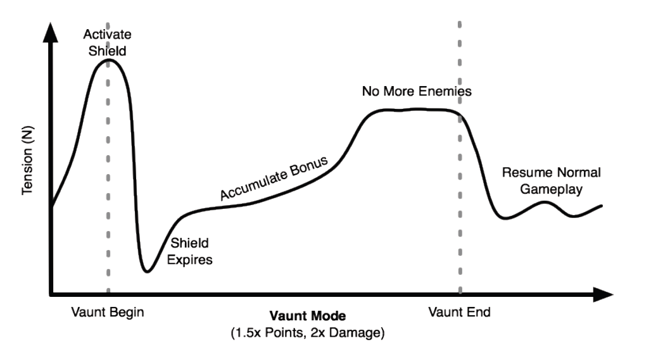
Key Concepts
  Gameplay tension
    Something important is at stake. What will happen?
    Gameplay tension comes from the challenges (gameplay)
    Tolerates randomness and repetition for much longer

Slide 52
The Storytelling Engine
Weaves together the gameplay and the story
How does it work?
  Receives triggers from the core mechanics to track the player’s progress
  Presents the narrative at the correct time
  Sends triggers to the core mechanics
Core mechanics and storytelling engine constantly interact

Slide 53
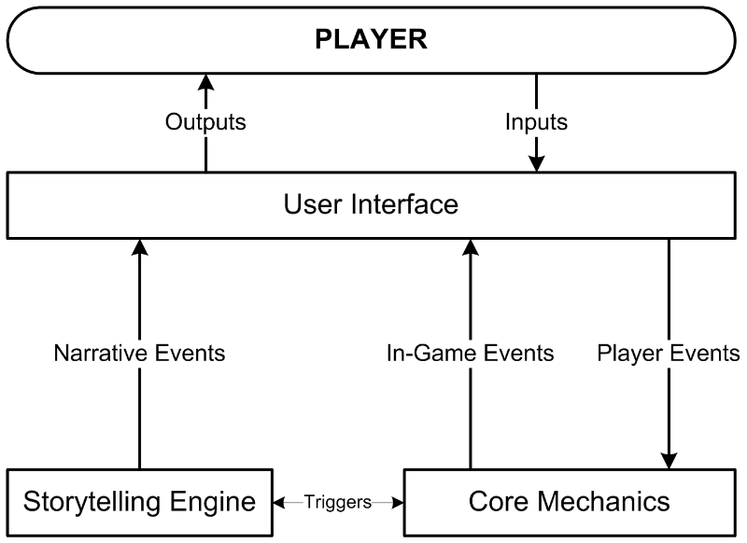
The Storytelling Engine
The storytelling engine works with the core mechanics to create the complete story-like experience

Slide 54
Linear Stories
Players cannot change the story
  Challenges are part of the story
  Pros and cons of linear stories:
They require less content than nonlinear ones
The storytelling engine is simpler
They are less prone to bugs and absurdities
They are capable of greater emotional power
They deny the player dramatic freedom
They reduce the replay-value of the game

Slide 55
Nonlinear Stories
Branching stories
  Provide a different experience when different choices are made
  Player has an immediate, deferred, or cumulative effect on the game
  More expensive and complicated to build than linear stories
  The player must play repeatedly to see all the content

Slide 56
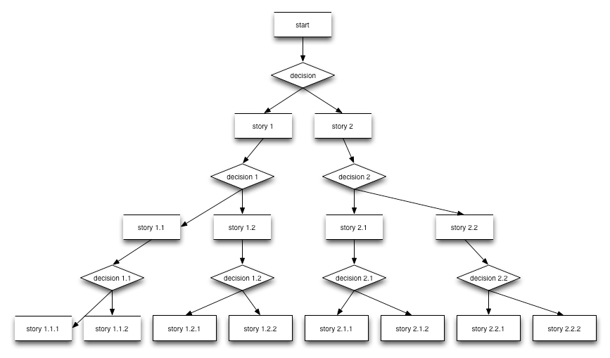
Nonlinear Stories

Slide 57
Nonlinear Stories
Foldback stories
  Compromise between branching and linear stories
  Plot branches, but the branches fold back into a single inevitable event
  Offer players some dramatic freedom without the cost and complexity of a branching story
  Easiest nonlinear story type to devise and most commercially successful

Slide 58
Nonlinear Stories
Emergent narrative
  Storytelling produced entirely by player actions and in-game events
    Story emerges from act of playing
  More dramatic freedom because the sequence of events is not fixed by a story structure
  Puts a perhaps impossible burden on the core mechanics to produce credible stories
  At present, no commercial games use purely emergent narrative

Slide 59
Nonlinear Stories
Endings
  Include multiple endings to provide an outcome that reflects the player’s dramatic actions
  Should provide an emotionally satisfying conclusion
  Use multiple endings if each one will wrap up the story in a way consistent with player’s choices and play

Slide 60
Granularity
Frequency of presenting narrative to the player
Large granularity reflects less frequent narrative blocks
Small granularity reflects more frequent narrative blocks

Slide 61
Mechanisms for Advancing the Plot
Story as a series of challenges or choices
  Plot advances as the player meets challenges or makes choices
  Common method of plot advancement
Story as a journey
  Arriving at a location triggers plot movement
  Provides novelty
  Player controls the pace

Slide 62
Mechanisms for Advancing the Plot
Story as a drama
  Storytelling engine advances the plot
  Player cannot control the pace
  Not a common method

Slide 63
Emotional Limits of Interactive Stories
The avatar’s death is usually regarded as a temporary setback rather than death in the real sense
Story needed to arouse complex emotions
Emotional limits of nonlinear stories
  Alternate endings might not be the most powerful
  Designers often create a single ending so players experience emotionally satisfying end
Emotional limits of avatar-based games
  Avatar should survive
  Companions can die

Slide 64
Scripted Conversations and Dialog Trees
Use a dialog tree to design scripted conversations
Choosing from several possible responses injects the player’s personality
Player’s choices can affect the core mechanics

Slide 65
When to Write the Story
Make a list of episodes or levels during the concept stage
Write the story during the elaboration stage

Slide 66
Other Considerations
Remember that you are creating an interactive game, not writing a novel
Sequels are a vital source of income
Creating episodes and delivery systems could provide more income in the future

Slide 67
Fun stuff
The first game to have a complex backstory was the arcade game Millipede (Atari, 1982).
  Since technology of the time limited what you could portray at the beginning of the video game, Atari chose to put the backstory on a poster and flyer that was distributed in the arcades.
  This backstory, The Archer and the Millipede, is shown on pg 82 of your book - you will notice 11 carefully crafted elements designed to get players of the time to engage with the game.

Slide 68
What Are the Core Mechanics?
Core mechanics consist of algorithms and data that precisely define the rules
  Implementation of mechanics varies as project goes through design process
  Player does not experience core mechanics directly
The game engine is the part of the software that implements the game’s rules

Slide 69
What Are the Core Mechanics?
Functions of the core mechanics in operation
  Operate the internal economy
  Present active challenges
  Accept player’s actions and determine their consequences
  Operate the AI of nonplayer characters
  Switch the game from mode to mode
  Transmit triggers to the storytelling engine

Slide 70
What Are the Core Mechanics?
Real-time games versus turn-based games
  In a real-time game, many mechanics are processes that operate continuously
  In a turn-based game, mechanics compute the effects of the player’s actions after each turn
Core mechanics and level design
  Design should specify how challenges work in general but not which challenges each level will contain

Slide 71
Key Concepts
A resource is a type of object or material that can move or exchange within the game
  Resources are handled as numeric quantities
  Core mechanics define how resources are used or traded and how they enter and leave the game
Note: resources are not objects but types of objects
  “Pencils” are a resource
  “This pencil” or “these 3 pencils” are entities

Slide 72
Key Concepts
An entity is an instance of a resource or the state of some element of the game world
  A simple entity is defined by one attribute
  A compound entity is defined by multiple attributes
  A unique entity occurs when the game world contains only one entity of a specific type

Slide 73
Key Concepts
Mechanics document how the game world and everything in it behaves
  States the relationships among entities
  A global mechanic operates throughout the game
  Identifies the events and processes that take place among the resources and entities
  Tracks the conditions that trigger events and processes

Slide 74
Key Concepts
Numeric and symbolic relationships
  A numeric relationship between entities is defined in terms of numbers and arithmetic operations
  The values of symbolic entities can’t be added or manipulated mathematically
    You must define how symbolic entities change state
    Symbolic entities can control mathematical operations on other numeric entities

Slide 75
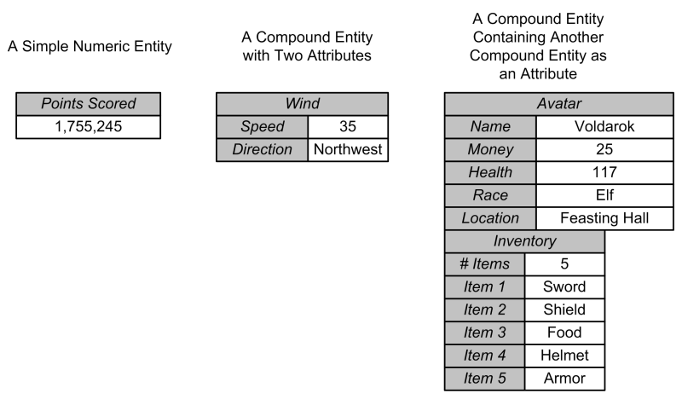
Example: Entity

Slide 76
Key Concepts
A source is how a resource or entity comes into the game world
  A mechanic identifies a spawn point, its location, the generated resource, and the frequency
  Sources can produce resources automatically when started by the player
  Sources can be global mechanics
  Sources can be limited or unlimited

Slide 77
Key Concepts
Drains remove resources from the game
Converters turn a resource into a different type of resource
Traders change the ownership of resources
Production mechanisms make a resource available to players

Slide 78
Key Concepts
Resources can be tangible or intangible
  Tangible resources possess physical properties
  Intangible resources do not occupy space or require transportation
In a feedback loop, a production mechanism requires some of the resource that the mechanism itself produces
  Not a problem unless the system runs out of the resource
    This produces deadlock

Slide 79
Key Concepts
Two production mechanisms that require each other’s output as inputs are mutually dependent
In static equilibrium, the amount of resources produced and consumed remains the same
In dynamic equilibrium, the amount of resources produced and consumed fluctuates cyclically

Slide 80
Core Mechanics and Gameplay
Core mechanics present challenges to the player and accept actions from the player
  Core mechanics implement the mechanisms to operate challenges
  Core mechanics perform tests to see if a challenge has been surmounted
  Passive challenges (such as static obstacles) do not require mechanics to operate
  Active challenges require mechanics that implement their activity

Slide 81
Core Mechanics and Gameplay
Actions and the core mechanics
  Actions available to a player normally do not change much from level to level
  Player actions trigger mechanics
  Complicated actions may involve manipulation or storage of data
    In this case you must create both an event mechanic that implements the action and an entity that stores the data

Slide 82
Designing the Core Mechanics
Goals of core mechanics design
  Keep it simple and elegant
  Create generalized systems from patterns
  Use iterative refinement
  Provide details when appropriate

Slide 83
Designing the Core Mechanics
Revisit earlier design work on the project to identify entities and mechanics
  Nouns in design documents will probably be implemented as entities or resources or both
  Verbs are actions that will be implemented as mechanics
  “If” and “when” statements identify conditions that trigger and control mechanics

Slide 84
Designing the Core Mechanics
List the entities and resources
  Does a noun describe a resource or an entity?
  If an entity, is the entity simple or compound?
  If a compound entity, what attributes describe it?

Slide 85
Designing the Core Mechanics
Add the mechanics
  Remember that mechanics consist of relationships, events, processes, and conditions
  Think about your resources
  Study your entities
  Analyze challenges and actions
  Look for global mechanics

Slide 86
Random Numbers and the Gaussian Curve
For pseudo-random numbers, a seed generates the sequence of random numbers produced by the algorithm
In uniform distribution, the chance of getting any number equals the chance of getting any other number

Slide 87
Random Numbers and the Gaussian Curve
In nonuniform distribution, generate more than one uniformly distributed random number and add the resulting numbers to get a value
Using nonuniform distribution creates a Gaussian curve

Slide 88
Avoiding Dominant Strategies
Dominant strategy is a strategy that reliably produces the best outcome a player may achieve, no matter what his opponent does
Dominant strategies are undesirable because a player has no reason to use any other strategy once she has discovered the dominant strategy

Slide 89
Avoiding Dominant Strategies
Dominant strategies in video games
  Transitive relationships among three or more entities
    If A > B and B > C, then A > C
      Never any reason to choose B or C if A is best
    To correct the imbalance, assign costs to each choice
    To create a more interesting choice, impose shadow costs for choices
    Transitive relationships often used to create upgrades for a player’s abilities—start with C and earn B, then A

Slide 90
Avoiding Dominant Strategies
Dominant strategies in video games
  Intransitive relationships (rock-paper-scissors)
    If A beats B and B beats C, you can’t assume A beats C
    Rather, A beats B, B beats C, and C beats A
    RPS model is simple but can be adjusted by modifying core mechanics
  Orthogonal unit differentiation
    Each kind of unit should be unlike the others in a different dimension
    Guarantees each kind of unit has a unique function

Slide 91
Avoiding Dominant Strategies
Dominant strategies in PvE games
  Implementing fewer actions in a game risks creating exploits
    Actions that can beat any challenge
  Test thoroughly to eliminate exploits

Slide 92
What Is a Balanced Game?
A balanced game
  Is fair to the player(s)
  Is neither too easy nor too hard
  Makes the skill of the player the most important factor in determining his success
Concept of balance differs between PvP and PvE games

Slide 93
What Is a Balanced Game?
A well-balanced PvP or PvE game has the following characteristics:
  It provides meaningful choices
    It avoids dominant strategies
    Each strategy must have a reasonable chance of producing victory
  Player’s skill must affect success
    Role of chance should not be so great that player skill becomes irrelevant

Slide 94
What Is a Balanced Game?
Additional balance requirements for PvP
  Players perceive the game to be fair
  A player who falls behind should have opportunities to catch up
  Game rarely ends in a stalemate
  Level of difficulty must be consistent

Slide 95
The Role of Chance
If chance plays a role, how to ensure the more skillful player wins?
  Use chance sparingly
  Use chance in frequent challenges with small risks and rewards
  Allow player to choose actions
  Allow player to choose how much to risk

Slide 96
Making PvP Games Fair
To balance symmetric games, treat every player the same
  Same rules, resources, victory conditions
Asymmetric games are harder to balance
  Give players identical quantities of materials or points when they start
  Players spend points to build units as they wish
  Unit attributes should differ among players

Slide 97
Making PvP Games Fair
Balance issues for persistent worlds
  Persistent worlds are never symmetric and always intrinsically unbalanced
  New players need protection
  Can be rebalanced on the fly by patching

Slide 98
Making PvE Games Fair
A fair PvE game should
  Offer challenges at a consistent level of difficulty
  Avoid learn-by-dying designs
  Avoid stalemates
  Provide information for critical decisions
  Avoid requiring extrinsic information
  Include challenges appropriate for the genre

Slide 99
Managing Difficulty
Balancing a game includes managing the difficulty of its challenges to keep players within a flow state
Factors outside the designer’s control
  Previous experience facing challenges similar to those in your game
  Native talent such as hand-eye coordination and reasoning skills
Flow occurs when the player’s abilities balance the challenge

Slide 100
Managing Difficulty
Types of difficulty
  Absolute difficulty
    Compare amounts of skill required and stress to that of a similar trivial challenge
  Relative difficulty
    Difficulty relative to player’s power provided by the game
    Power provided measures player’s strength by means appropriate to situation
    e.g. Weapon strength in shooters
  Perceived difficulty = absolute difficulty − (power provided + in-game experience)

Slide 101
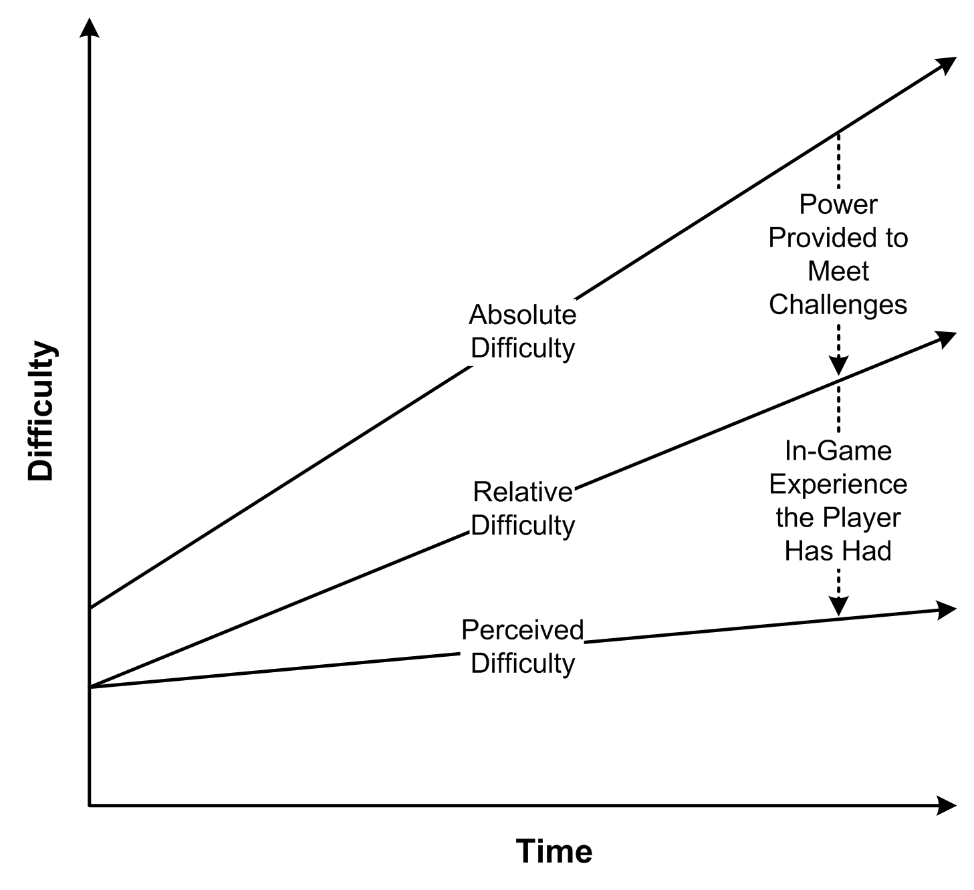
Managing Difficulty

Slide 102
Managing Difficulty
Creating a difficulty progression
  Perceived difficulty of challenges should stay the same or rise
    In games for casual players and young children, it should remain almost flat
  Relative difficulty must increase over time to counteract the player’s growing in-game experience

Slide 103
Managing Difficulty
Establishing difficulty modes
  In single-player games, allow player to choose a difficulty mode
  When a difficulty mode is selected, challenges must stay within that range
  If you can’t adjust the difficulty of a challenge, provide a way around it for the easy mode and block the go-around route for the hard mode

Slide 104
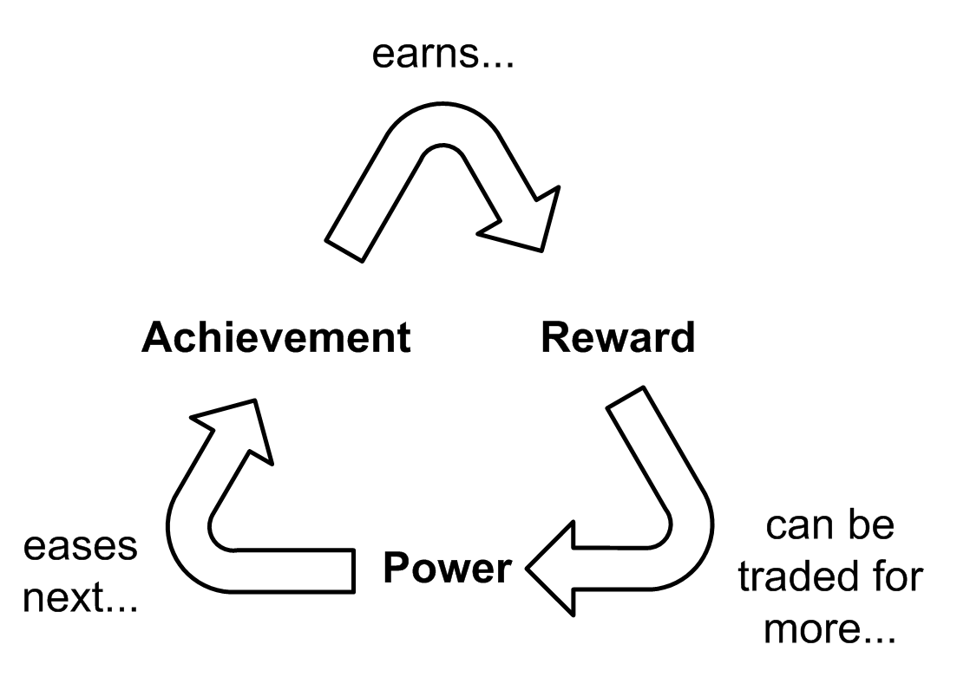
Understanding Positive Feedback
Positive feedback occurs when a player’s achievement changes the game state, making future achievements easier
Benefits of positive feedback
  Discourages a stalemate
  Rewards success

Slide 105
Understanding Positive Feedback
Controlling positive feedback
  Don’t give too much power as a reward
  Introduce negative feedback
  Raise the absolute difficulty level of challenges as the player proceeds
  Allow collusion against the leader
  Define victory as unrelated to the feedback cycle
  Use chance to reduce the size of the rewards

Slide 106
Other Balance Considerations
Avoid stagnation
  Stagnation occurs when the player does not know what to do next
    Hide clues in plain sight about how to proceed
    Have the game detect when the player is wandering aimlessly and provide nudges in the right direction
Avoid trivialities
  Let the computer handle uninteresting details of game

Slide 107
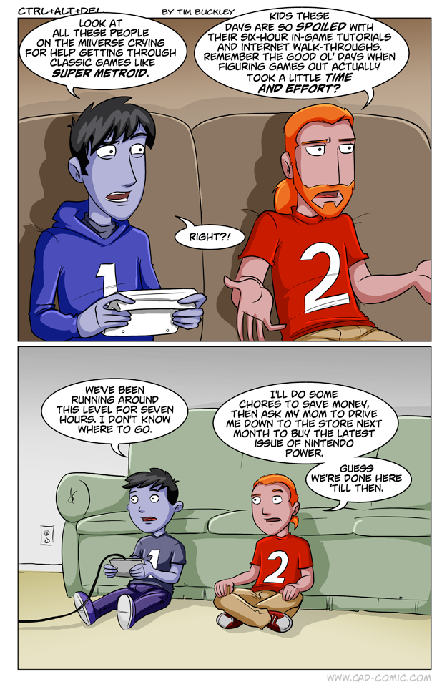

Slide 108
Design to Make Tuning Easy
Generalize mechanics when possible
  Try to avoid creating special cases
Separate code and data
Suggestions for efficient fine-tuning:
  Modify only one parameter at a time
  When modifying parameters, make big adjustments—the consequences are easier to see
  Keep records
  Use pseudo-random numbers

Slide 109
What Is Level Design?
Level Design
  Constructing the experience for the player using components from the game designer
  Level Designers create:
Space in which the game takes place
Initial conditions of the level
Set of challenges within the level
Termination conditions of the level
Interplay between gameplay and story
Aesthetics and mood of the level

Slide 110
Key Design Principles
Universal level design principles
  Make the early levels of a game tutorial levels
  Vary the pacing of the level
  When the player surmounts a challenge that consumes his resources, provide more resources
  Avoid conceptual non sequiturs
  Clearly inform the player of his short-term goals

Slide 111
Key Design Principles
Universal level design principles
  Be clear about risks, rewards, and consequences
  Reward the player for skill, imagination, intelligence, and dedication
  Reward in a large way, punish in a small way
  The purpose of an artificial opponent is to put up a good fight and then lose
  Implement multiple difficulty settings

Slide 112
Key Design Principles
Genre-specific level design principles
  Action game
    Vary the pace
  Strategy game
    Reward planning
  Role-playing game
    Offer opportunities for character growth and player self-expression
  Sports game
    Realism is vital
  Vehicle simulation
    Reward skillful maneuvering

Slide 113
Key Design Principles
Genre-specific level design principles
  Construction and management simulation
    Offer an interesting variety of initial conditions and goals
  Adventure game
    Construct challenges that harmonize with their locations and the story
  Artificial life game
    Create many interaction opportunities for the creatures in their environment
  Puzzle game
    Give the player time to think

Slide 114
Layouts
Open layouts
  Allow unconstrained movement
  Correspond to the outdoors
  Used in war games and role-playing games
Linear layouts
  Require player to move in a fixed sequence
  Player can move only to next or previous area
  Used traditionally in side-scrolling action games and rail-shooters

Slide 115

Layouts
Parallel layouts
  Modern variant of linear layouts
  Variety of paths can go through the level
  Can reflect a foldback story structure
Ring layouts
  Path returns to its starting point
  Oval tracks or twisting road-racing tracks are rings
  Used for racing games

Slide 116
Layouts
Network layouts
  Spaces connect to other spaces in different ways
  Give the player freedom to take any path
  Stories must be able to tolerate player experiencing events in any sequence
Hub-and-spoke layouts
  Central hub is usually a safe zone
  Provides some choice of where to go
  Lock off some areas to control player experiences

Slide 117
Layouts
Combinations of layouts
  Combines aspects of several layout types
  Role-playing games and adventure games often use combination layouts

Slide 118
Expanding on the Principles
Level designer assembles components to create the atmosphere
  Lighting
  Color palette
  Weather and atmospheric effects
  Special visual effects
  Music
  Ambient audio
  Special audio effects

Slide 119
Expanding on the Principles
Pacing refers to the frequency of individual challenges
  Genre affects pacing
    Multiplayer deathmatch shooters use the fastest pace
    Adventure games use the slowest pace
  Vary the pacing with fast and slow periods
  Overall pacing should remain steady or become more difficult near the end of the level

Slide 120
Expanding on the Principles
Tutorial levels teach the player how to play
  Scripted or partially scripted experience that explains the game’s user interface, key challenges, and actions
  Voiceover narration, text, or a special character can explain the game

Slide 121
The Level Design Process
Design to level design handoff
  List features in the level
  Create a rough overview map of the level
Planning phase
  Plan the level in detail
  Plan the sequence of events
  Document the gameplay, art, performance, and code requirements

Slide 122
The Level Design Process
Prototyping
  Construct temporary models of the landscape and objects
  Models serve as blueprints for the art team
Level review
  Review the prototype
  Feedback from the design, art, programming, audio, and testing teams

Slide 123
The Level Design Process
Level refinement and lock-down
  Make corrections based on feedback
  Review and correct until the level is flawless
  Lock the level
Level design to art handoff
  Give all files to the artists
  Tell artists how the level should look and work
  Contact the audio team for any needed audio

Slide 124
The Level Design Process
First art and rigging pass
  Art team builds the real artwork and rigging
  You might need to incorporate the new content into software
Art to level design handoff and review
  Receive final artwork
  Conduct a review

Slide 125
The Level Design Process
Content integration
  Assemble all the assets into the completed level
  Adjust any rigging as necessary
Bug fixing
  Test for bugs and mistakes and hand off to QA
User testing and tuning
  QA creates a test plan and begins alpha testing
  When thoroughly alpha tested, hand off to beta testing

Slide 126
Pitfalls of Level Design
Get the scope right
  Design within your available resources
  It’s common to design something that’s too big
Avoid illogical events
  Illogical events in a game make it harder to play
  Players should be rewarded for using their intelligence

Slide 127
Pitfalls of Level Design
Make atypical levels optional
  Atypical levels break the player’s suspension of disbelief
  Atypical levels could prevent some players from completing the game
Don’t show the player everything at once
  Introduce new features gradually
  Maintain the player’s interest

Slide 128
Pitfalls of Level Design
Never lose sight of your audience
  Player-centric approach
  Understand your target audience and deliver what they want

